Slide 1
ICT4SILVER
Digital technologies to address Silver Economy needs
Products & services experimented in living lab.
An INTERREG SUDOE project.

Slide 2
The Project
The Southwest of Europe will have the oldest population of Europe before 2050. The ICT4SILVER project aims at bringing to the SUDOE territory answers to these challenges.
The project is going to cross needs expressed in 5 main scopes of Silver Economy:
Health and medical and social
Autonomy of the people and the preservation at home
Housing environment and town planning
Transport and mobility
Prevention of the ageing with the potential of innovation brought by digital technologies (sensors, software solutions, big dated, internet of objects etc.).
On this base, ICT4SILVER will advice SME of the European Southwest to help them launch on the market of innovative products/services integrating ICT technologies into intended applications.
Collection of Silver Economy actors needs
Mapping of Silver Economy actors
Expression of interest to identify the possible
digital responses
Selection of 10 demonstrators
Metaclustering broadcast
Dissemination event

Slide 3

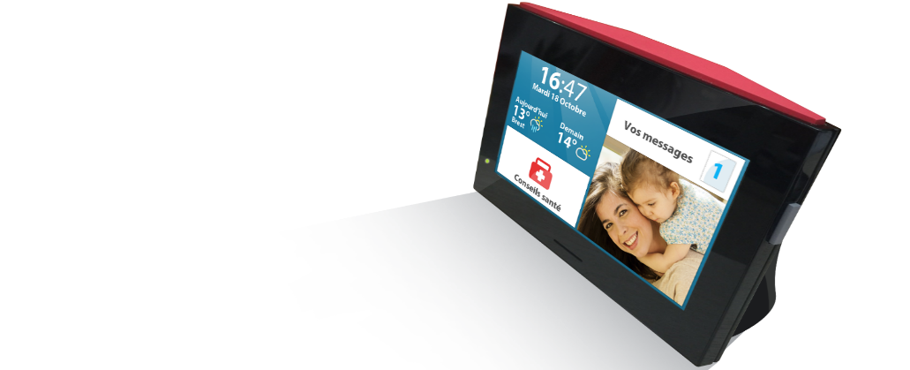
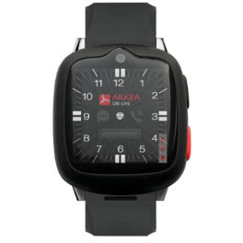
ARKEA ON LIFE
  Telecare Solutions for Elderly people
  We are dedicated to create solutions for the safety of our customers at home and outside. The Profile-type of our customers : 82 Years old, 80% of women.
  2 main Products
    We have developed a specific solution for Home telecare with
    a tablet since the beginning of this year with Video calls.
    For outside, we have developed a smartwatch (with its own Sim Card) which allows to launch an alert every where in Europe.
  Usage specificities
    At home : video calls with the emergency call center, video calls from the family, message, pictures.
    Outside : geofencing to get the location of the customer.

Slide 4
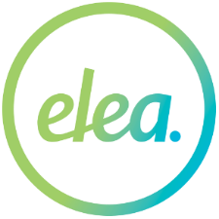
ELEA SOLUCIONES
  Sector of activity, customers
  Disabled and elderly people who want to stay at home more time. EleaOpen helps getting smarter and barrier-free homes for those living with disabilities. Public and private telecare companies.
  Product presentation
  EleaOpen enables a resident to open their front door and main entrance door without exerting any force by using mobile APP. It is easy to check door status anytime or from anywhere.
  Usage specificities
  Allows telecare companies and health assistant to come into elderly’s home without physically key to improve assistance in a faster and safer way. Also disabled people come in and come out to their houses in autonomous way.

Slide 5

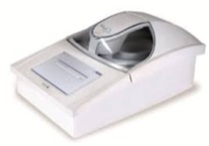
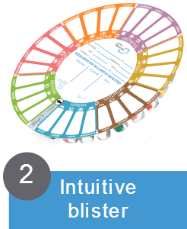
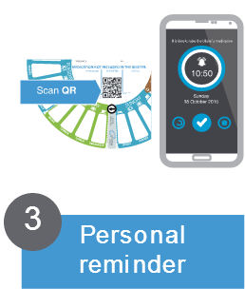
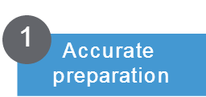
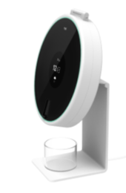
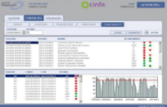
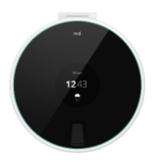

FAGOR HEALTHCARE
  FAGOR Healthcare develops, manufactures and markets a new pharmacy service Medical Dispenser, that helps chronic patients improve their health by taking their medication correctly.
  MD4U is a new device in Medical Dispenser Service, that helps chronic patients improve more their health by taking their medication correctly (taking prescribed drugs at the right dose and at the right time). All other pills are safely locked in the dispenser, helping prevent an incorrect dose or an overdoses being taken.
Preparation
Program alarms
Take medication
alarms, register
Control
patient adherence

Slide 6

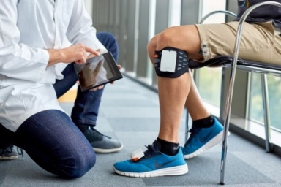
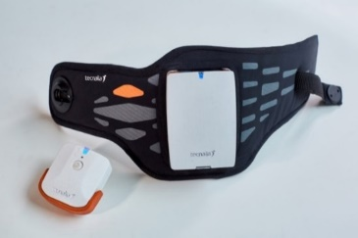
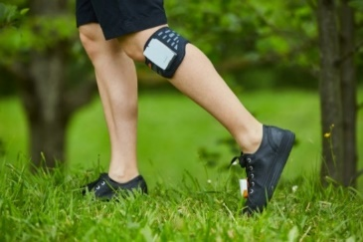
FESIA TECNOLOGY
  Sector of activity, customers
  Fesia aims to enter the neuro-rehabilitation sector, selling our products to rehab centers and hospitals.
  Product presentation
  FesiaWalk is a functional electrical stimulating device for the rehabilitation of dropped foot syndrome caused by injury or disease of the central nervous system.
  Usage specificities
  The device is designed to be used throughout the whole gait rehabilitation processes

Slide 7

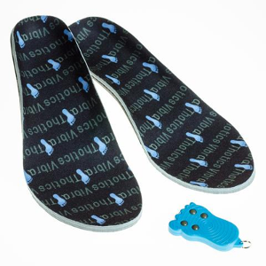
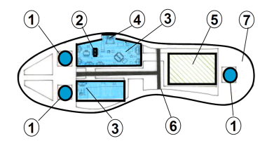
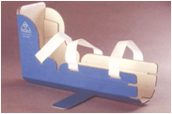
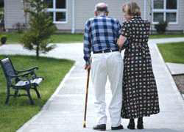
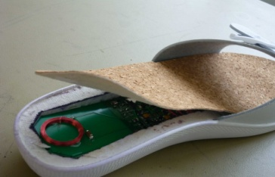
HEXABIO
  HEXABIO is a company specialized in the development of innovative orthopedics devices to several hospitals and clinics in Europe.
  HEXABIO develops a large range of orthosis and different orthopedics implants for the hand, the foot and the pediatric surgery.
  HEXABIO is building different therapeutic systems like sensitive vibrating soles and is constructing the protocol and procedures to introduce these systems on different aspects of quality of life of old people at home.

Slide 8

IDEABLE SOLUTION
  Sector of activity, customers
  Ideable ( www.ideable.net ) is a software company specialized on web, cloud and mobile solutions for eHealth sector, Industry and public organizations.
  Product presentation
  "Kwido caregivers" is a specific solution for health monitoring using smartphones from the Kwido platform for caring for elderly people.
  Usage specificities
  "Kwido caregivers" app needs a mobile or tablet for entering health information from elderly patients and a web-based backend for defining and raising alerts for doctors.

Slide 9

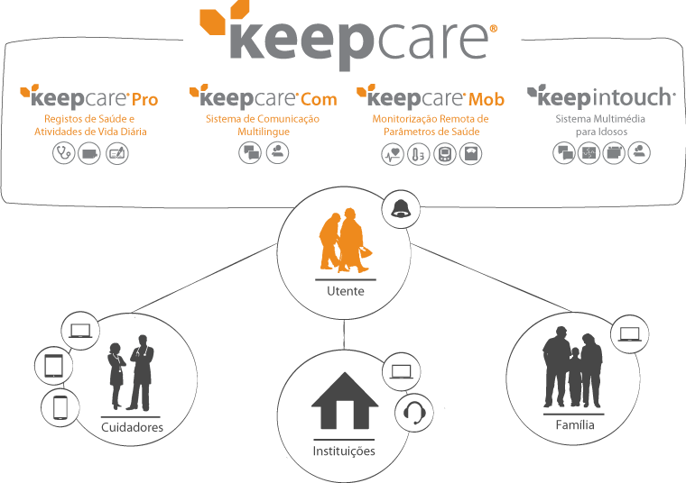
INCREASETIME
  Health and Wellbeing at your finger tips
  We provide innovative ICT health care solutions that promote the quality of life, independent and active ageing for all ages and older adults
  Register activities of daily living the easy way
  Whether the users are living in their homes or in a senior residence, our solutions allows not only a permanent indirect monitoring of health condition (and early response in case of an emergency) but also the simple registration of ADLs (including health, social and personal development)

Slide 10


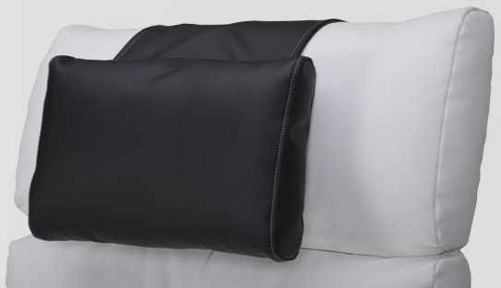
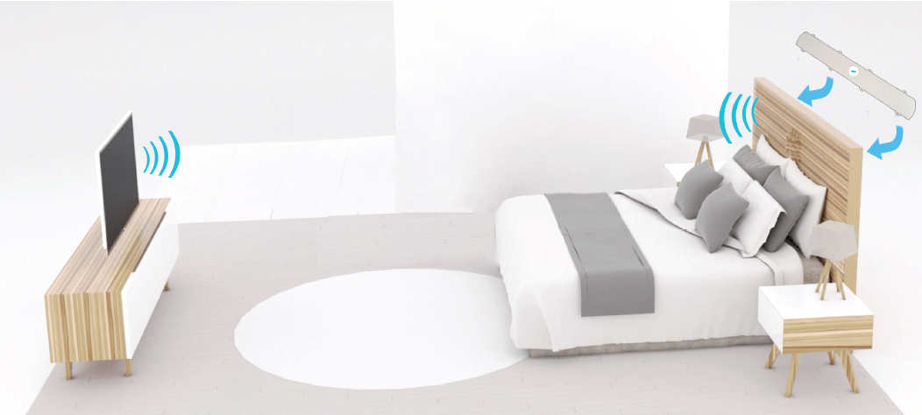
Life Design Sonore
NEW’EE® integrates sound within furniture. It broadcasts all kind of audio sources for a great listening comfort. The user benefits from a good sound quality neither using headphones nor increasing the volume. It can be reduced by at least 20 decibels, while ensuring excellent sound quality.

Slide 11

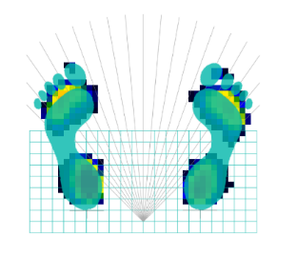
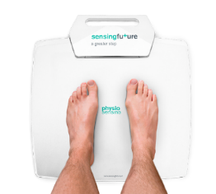
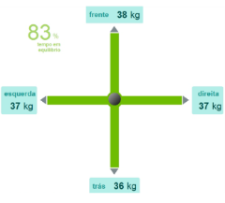
SENSING FUTURE TECHNOLOGIES
  Sector of activity, customers
    Medical Devices
    Activity Areas:
    Physical Rehabilitation Technology
    Robotics
    Telemedicine
  Product presentation
  Usage specificities
    Physical Rehabilitation Center or Physiotherapy Clinic
    Diagnose Mode or Therapeutic Exercise mode

Slide 12
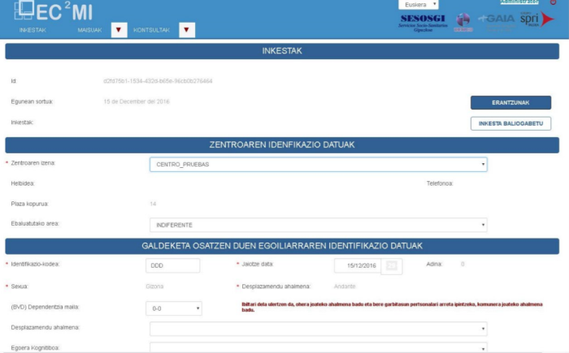
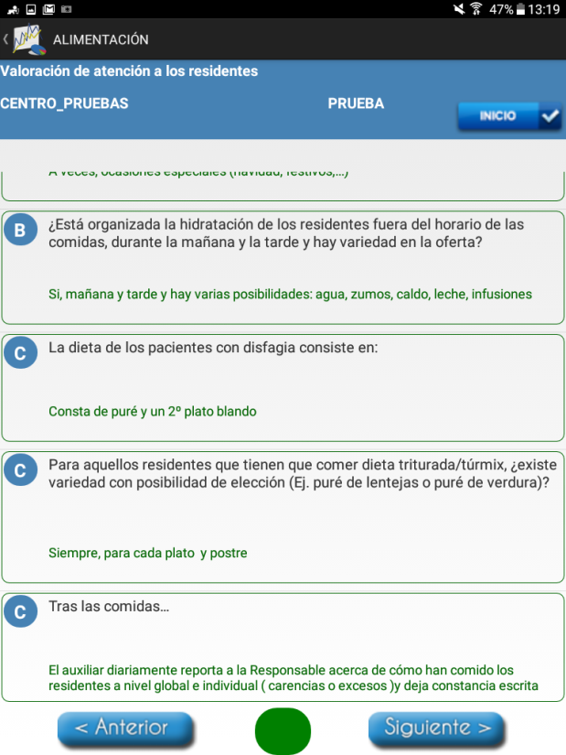
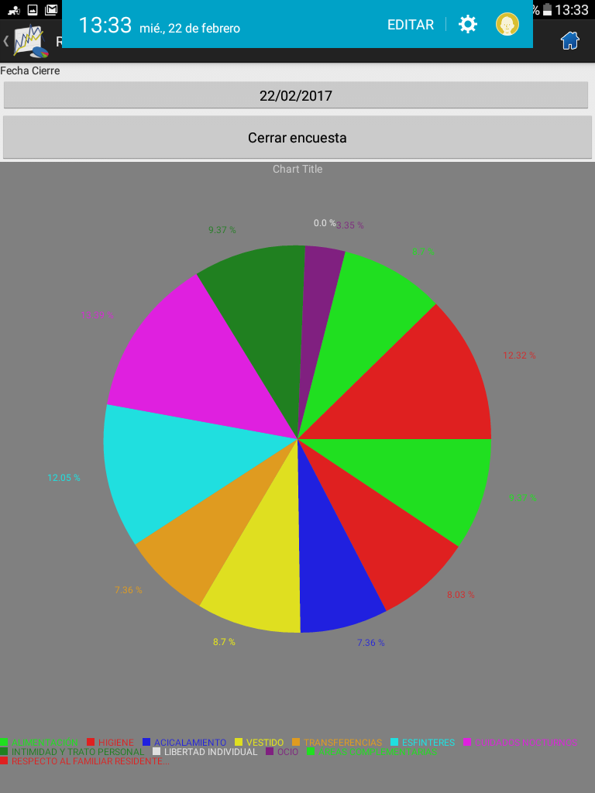
SESOSGI
  Sector of activity
  Services and Socio-sanitary Studies in Geriatrics, Nursing Homes, etc. (Public administration, private companies ...).
  Customers: Geriatric Residences of Gipuzkoa, Entities and Organizations and companies.
  Product presentation
  Evaluation tool for care in the gerontological residential environment.
  Usage specificities
  It is a software tool to use in residences, hospitals, sheltered homes, centers, spas ... both private and public.

Slide 13

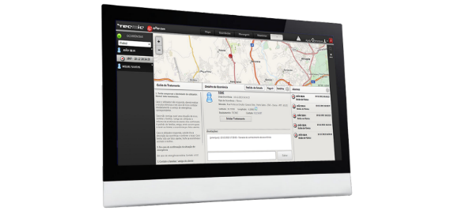
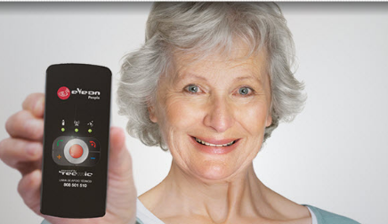
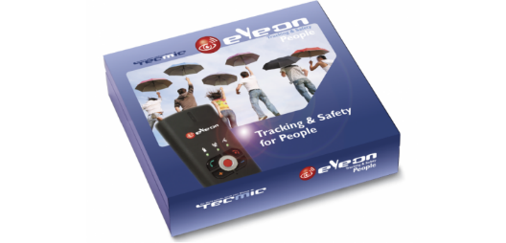
TECMIC
  Sector of activity, customers
  eYeOn allows social economy institutions to provide remote tele assistance services to their users delaying their institutionalization
  Product presentation
  eYeOn is an incident management online platform, using GIS and mobile communications to keep track of end users status and to treat the alarms.

Slide 14
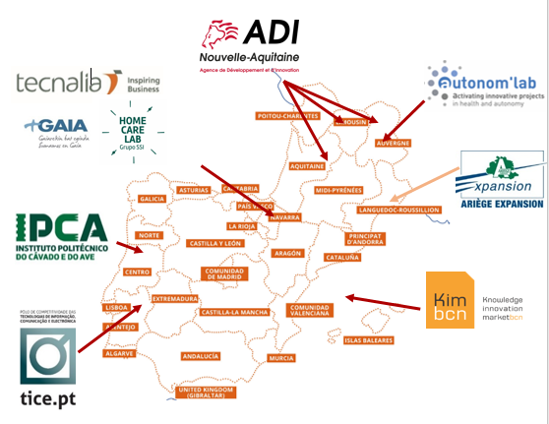
The partners
Hervé DUFAU - ADI Nouvelle-Aquitaine - h.dufau@adi-na.fr
Valentina MARGIOTTA- Autonom'Lab – v-argiotta@autonom-lab.com
Inma UZKUDUN - Grupo SSI - iuzkudun@grupossi.es
Béatrice DURRUTY- Cluster TIC SANTE - b.durruty@adi-na.fr
Iraitz MANTEROLA - Tecnalia - iraitz.manterola@tecnalia.com
Cristina MURILLO – Gaia - murillo@gaia.es
Ricardo SIMOES – IPCA -rsimoes@ipca.pt
João Pedro BARBOSA DA SILVA – IPCA - joao.silva@ipca.pt
Pedro ROSEIRO - Cluster TICE - pedro.roseiro@tice.pt
Isaac Matamoros – KIM - imatamoros@kimglobal.com

Slide 15
PARTNERS OF THE PROJECT

